Slide 1
A STUDY ON MERMIN-WAGNER THEOREM
By: Team D
Aditya Kumar Mandal-205120040
Murali K -205120005
Sudharsana Prasad G S-205120002

Slide 2
AIM AND OBJECTIVE OF THE STUDY
Overview of the Mermin-Wagner theorem
Relation of symmetry breaking to Phase Transition and Order Parameter
Overview of Ferromagnetism and Anti-ferromagnetism
History of the theorem
Derivation of Mermin-Wagner theorem
An overview of BB inequality
Mermin-Wagner theorem for Heisenberg model
Implementation of Mermin-Wagner theorem

Slide 3
OVERVIEW OF THE WAGNER-MERMIN THEOREM
Statement: At nonzero temperatures, a one-dimensional/two-dimensional isotropic spin Heisenberg model with finite-range exchange interaction can neither be Ferromagnetic nor Anti-ferromagnetic.
Generalized Statement: Continuous symmetries cannot be spontaneously broken at finite temperature in systems with sufficiently short-range interactions in dimensions d ≤ 2.
The above statement is proved from the application of Bogoliubov inequality.
The Bogoliubov inequality gives the relation between two arbitrary operators and the Hamiltonian of the physical system.
By applying Bogoliubov inequality to isotropic Heisenberg model and proving the absence of spontaneous magnetization or sublattice magnetization, for finite range interaction and nonzero temperature, we arrive at the concluding statement above.

Slide 4
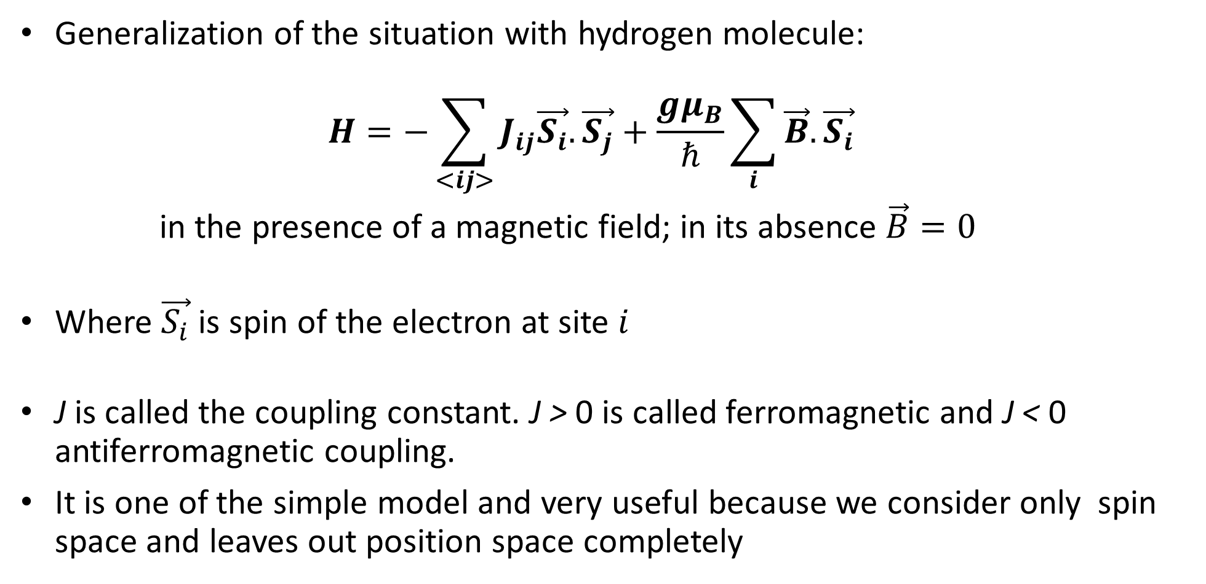
HEISENBERG MODEL
Generalization of the situation with hydrogen molecule: $H=−\sum_{<ij>}{J_{ij}\vec{S_{i}}.\vec{S_{j}}}+\frac{gμ_{B}}{ℏ}\sum_{i}{\vec{B}.\vec{S_{i}}}$
in the presence of a magnetic field; in its absence $\vec{B}=0$
Where $\vec{S_{i}}$ is spin of the electron at site $i$
J is called the coupling constant. J > 0 is called ferromagnetic and J < 0 antiferromagnetic coupling.
It is one of the simple model and very useful because we consider only spin space and leaves out position space completely

Slide 5
MATHEMATICAL FRAMEWORK

Slide 6
SYMMETRY BREAKING AND PHASE TRANSITION
Symmetry arguments gives idea about different phases and their corresponding phase transitions without even solving system rigorously.
Different phases of matter can be characterized by different types of symmetry.
At higher temperatures, matter takes on a ‘‘higher symmetry’’ phase; at lower temperatures, the phases are of lower symmetry or ‘‘broken symmetry.’’
The phase transition can be related to the failure of one of the phases to exhibit a certain symmetry property of the underlying Hamiltonians.

Slide 7
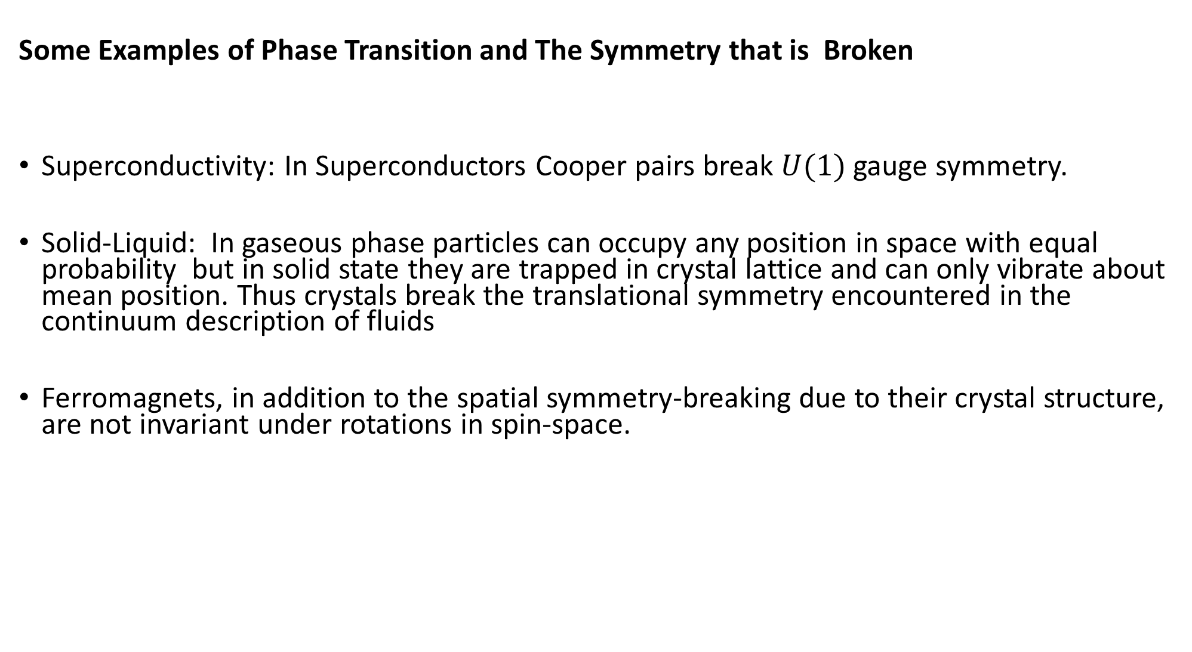
Some Examples of Phase Transition and The Symmetry that is Broken
Superconductivity: In Superconductors Cooper pairs break $U(1)$ gauge symmetry.
Solid-Liquid: In gaseous phase particles can occupy any position in space with equal probability but in solid state they are trapped in crystal lattice and can only vibrate about mean position. Thus crystals break the translational symmetry encountered in the continuum description of fluids
Ferromagnets, in addition to the spatial symmetry-breaking due to their crystal structure, are not invariant under rotations in spin-space.

Slide 8
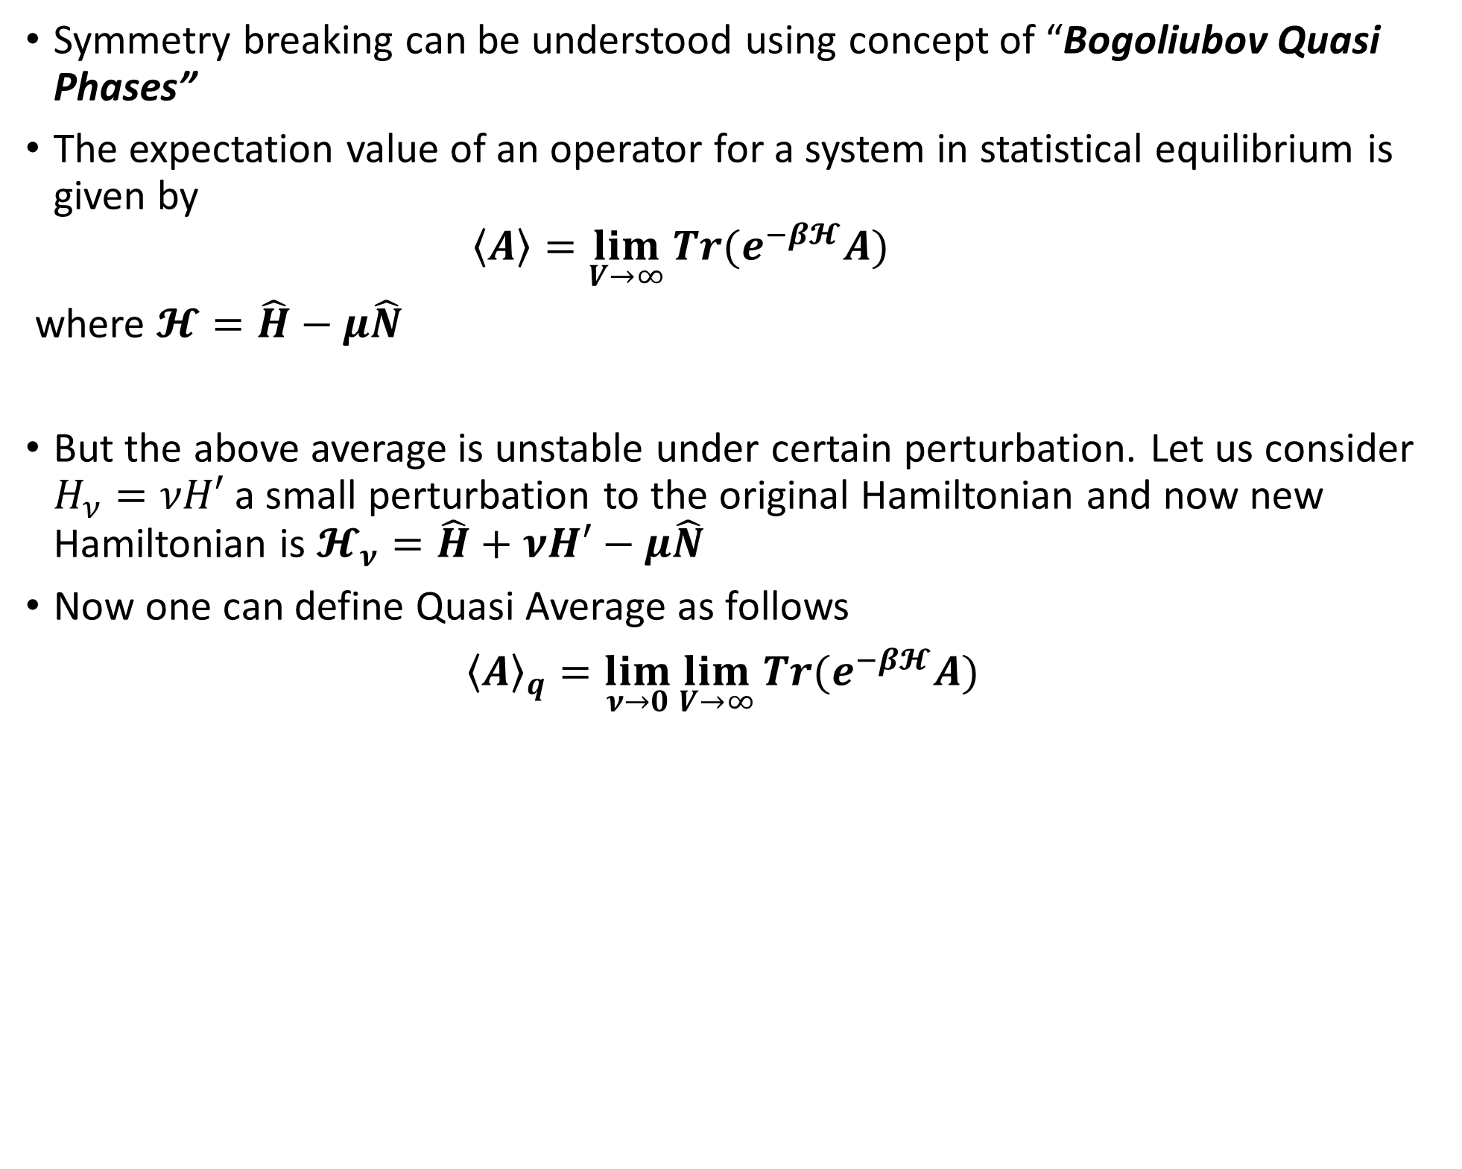
BOGOLIUBOV QUASI PHASES AND SYMMETRY BREAKING
Symmetry breaking can be understood using concept of “Bogoliubov Quasi Phases”
The expectation value of an operator for a system in statistical equilibrium is given by $\left\langle A\right\rangle =\lim_{V→∞}{Tr(e^{−β𝓗}A)}$
where $𝓗=\hat{H}−μ\hat{N}$
But the above average is unstable under certain perturbation. Let us consider $H_{ν}=νH′$ a small perturbation to the original Hamiltonian and now new Hamiltonian is $𝓗_{ν}=\hat{H}+νH′−μ\hat{N}$
Now one can define Quasi Average as follows
${\left\langle A\right\rangle }_{q}=\lim_{ν→0}\lim_{V→∞}{Tr(e^{−β𝓗}A)}$

Slide 9
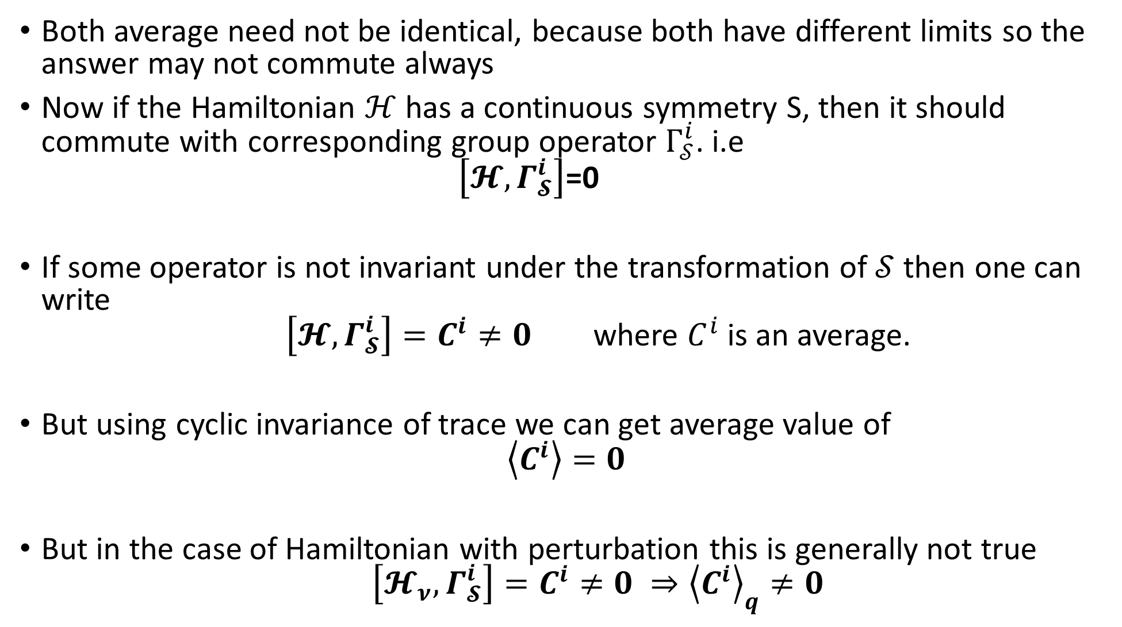
Both average need not be identical, because both have different limits so the answer may not commute always
Now if the Hamiltonian $ℋ$ has a continuous symmetry S, then it should commute with corresponding group operator $Γ_{𝒮}^{i}$. i.e $\left[𝓗,Γ_{𝓢}^{i}\right]$=0
If some operator is not invariant under the transformation of $𝒮$ then one can write $\left[𝓗,Γ_{𝓢}^{i}\right]=C^{i}≠0$ where $C^{i}$ is an average.
But using cyclic invariance of trace we can get average value of $\left\langle C^{i}\right\rangle =0$
But in the case of Hamiltonian with perturbation this is generally not true $\left[𝓗_{ν},Γ_{𝓢}^{i}\right]=C^{i}≠0 ⇒{\left\langle C^{i}\right\rangle }_{q}≠0$

Slide 10
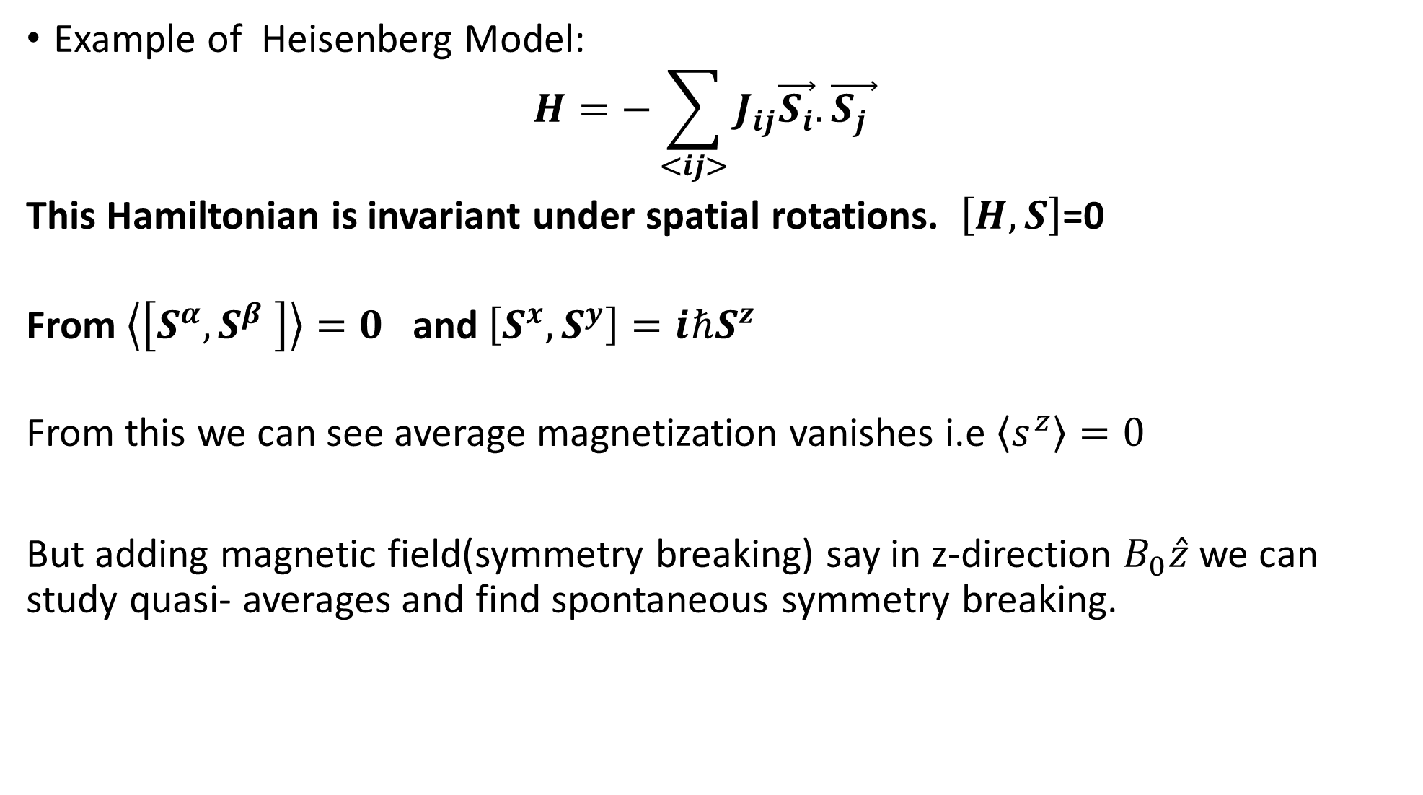
Example of Heisenberg Model: $H=−\sum_{<ij>}{J_{ij}\vec{S_{i}}.\vec{S_{j} }}$
This Hamiltonian is invariant under spatial rotations. $\left[H,S\right]$=0
From $\left\langle \left[S^{α},S^{β} \right]\right\rangle =0$ and $\left[S^{x},S^{y}\right]=iℏS^{z}$
From this we can see average magnetization vanishes i.e $\left\langle s^{z}\right\rangle =0$
But adding magnetic field(symmetry breaking) say in z-direction $B_{0}\hat{z}$ we can study quasi- averages and find spontaneous symmetry breaking.

Slide 11
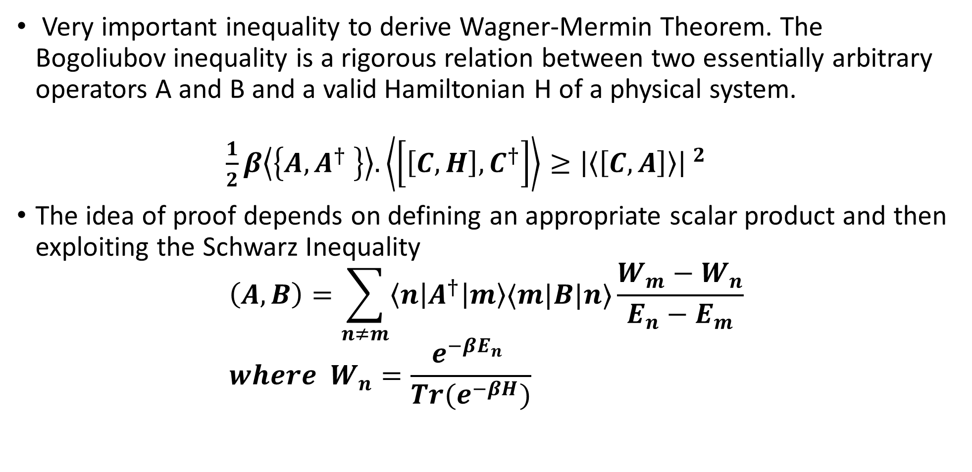
DERIVATION OF BOGOLIUBOV INEQUALITY
Very important inequality to derive Wagner-Mermin Theorem. The Bogoliubov inequality is a rigorous relation between two essentially arbitrary operators A and B and a valid Hamiltonian H of a physical system. $\frac{1}{2}β\left\langle \left\{A, A^{†} \right\}\right\rangle .\left\langle \left[\left[C,H\right],C^{†}\right]\right\rangle ≥{\left|\left\langle \left[C,A\right]\right\rangle \right| }^{2}$
The idea of proof depends on defining an appropriate scalar product and then exploiting the Schwarz Inequality
$$\left(A,B\right)=\sum_{n≠m}{\left\langle n\right|A^{†}\left|m\right\rangle ⟨m|B|n⟩\frac{W_{m}−W_{n}}{E_{n}−E_{m}}} \\ where W_{n}=\frac{e^{−βE_{n}} }{Tr(e^{−βH})}$$

Slide 12
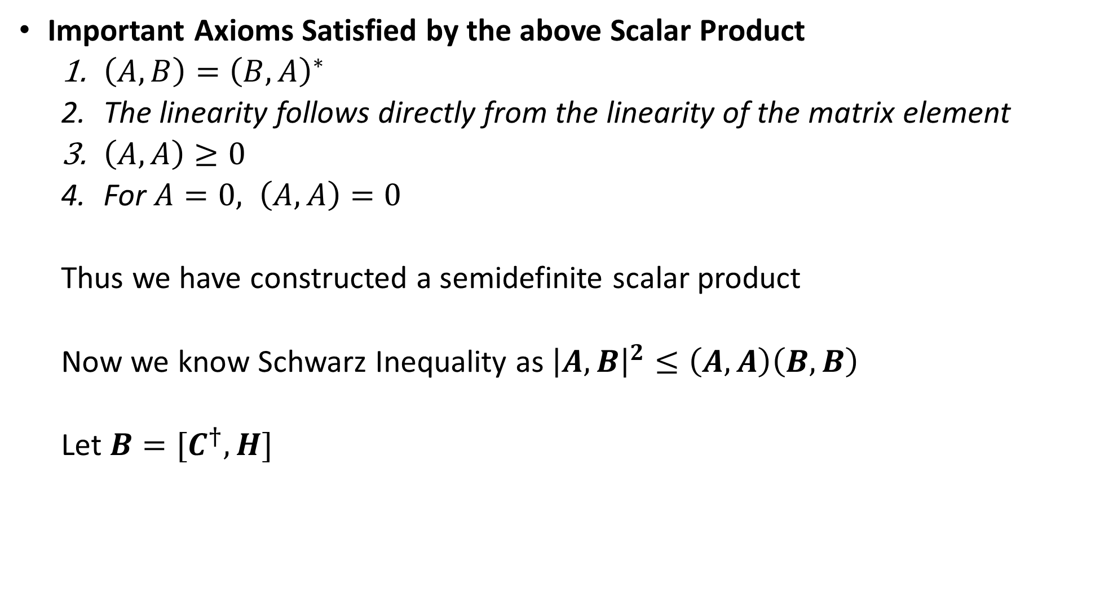
Important Axioms Satisfied by the above Scalar Product
$\left(A,B\right)={\left(B,A\right)}^{∗}$
The linearity follows directly from the linearity of the matrix element
$\left(A,A\right)≥0$
For $A=0, \left(A,A\right)=0$
Thus we have constructed a semidefinite scalar product
Now we know Schwarz Inequality as ${\left|A,B\right|}^{2}≤\left(A,A\right)\left(B,B\right)$
Let $B=[C^{†},H]$

Slide 13

$$\left(A,B\right)=\sum_{n≠m}{\left\langle n\left|A^{†}\right|m\right\rangle ⟨m|\left[C^{†},H\right]|n⟩\frac{W_{m}−W_{n}}{E_{n}−E_{m}}}$$ $$= \sum_{n,m}{\left\langle n\left|A^{†}\right|m\right\rangle ⟨m|C^{†}|n⟩(W_{m}−W_{n})}$$
$$=\sum_{m}{W_{m}\left\langle m\left|{C^{†}A}^{†}\right|m\right\rangle −\sum_{n}{W_{n}⟨n|{A^{†}C}^{†}|n⟩}}$$ $=\left\langle {C^{†}A}^{†}−{A^{†}C}^{†}\right\rangle =\left\langle \left[{C^{†},A}^{†}\right]\right\rangle$
Now let us substitute $B=\left[C^{†},H\right] we find$ $\left(B,B\right)=\left\langle \left[C^{†},\left[H,C\right]\right]\right\rangle ≥0$

Slide 14
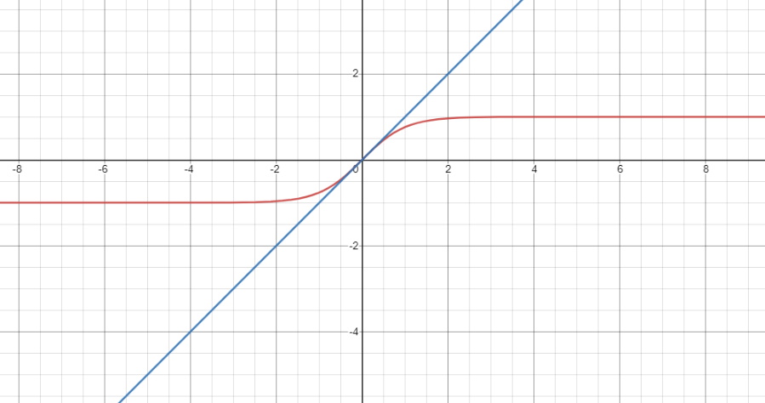
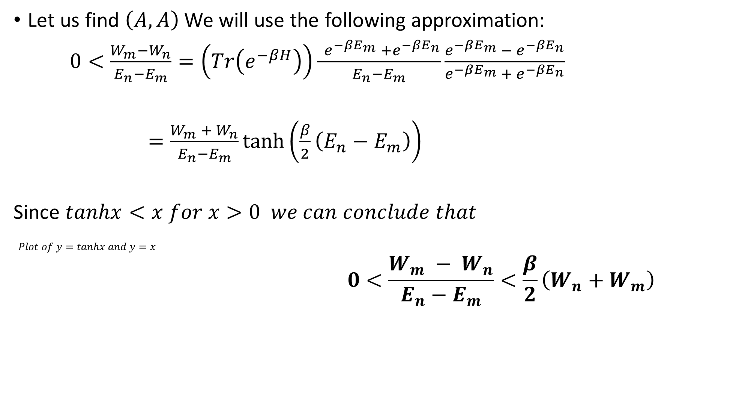
Let us find $\left(A,A\right)$ We will use the following approximation:
$0<\frac{W_{m}−W_{n}}{E_{n}−E_{m}}=\left(Tr\left(e^{−βH}\right)\right)\frac{ e^{−βE_{m}} +e^{−βE_{n}}}{E_{n}−E_{m}}\frac{e^{−βE_{m}} − e^{−βE_{n}}}{e^{−βE_{m}} +{ e}^{−βE_{n}}}$
$=\frac{W_{m} + W_{n}}{E_{n}−E_{m}}\tanh\left(\frac{β}{2}\left(E_{n}−E_{m}\right)\right)$
Since $tanhx<x for x>0 we can conclude that$
$Plot of y=tanhx and y=x$
$$0<\frac{W_{m} − W_{n}}{E_{n}−E_{m}}<\frac{β}{2}\left(W_{n}+W_{m}\right)$$

Slide 15

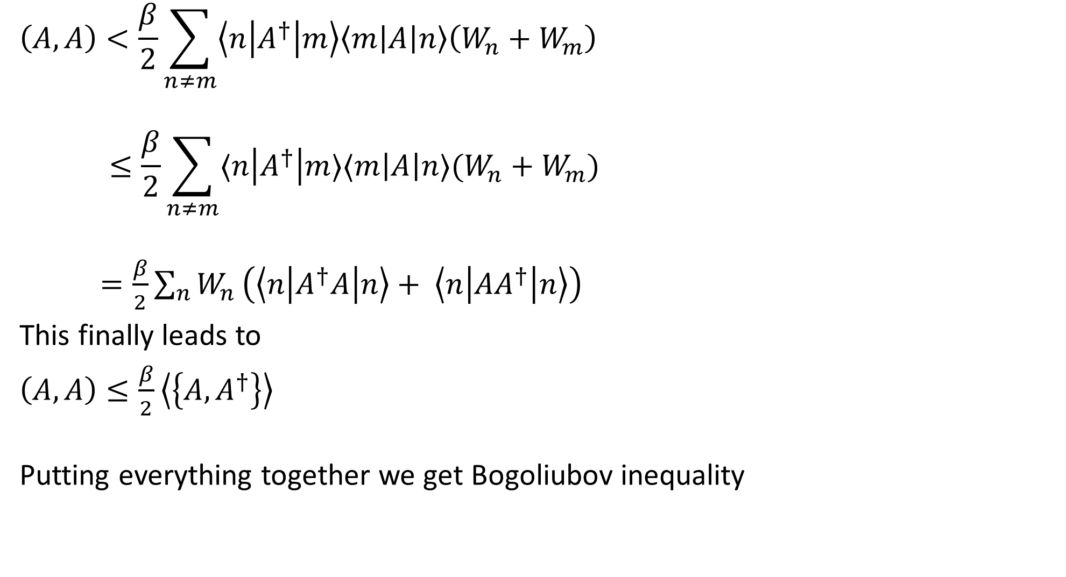
$$\left(A,A\right)<\frac{β}{2}\sum_{n≠m}{\left\langle n\left|A^{†}\right|m\right\rangle \left\langle m\left|A\right|n\right\rangle \left(W_{n}+W_{m}\right) }$$ $$≤\frac{β}{2}\sum_{n≠m}{⟨n\left|A^{†}\right|m⟩⟨m\left|A\right|n⟩(W_{n}+W_{m})}$$
$=\frac{β}{2}\sum_{n}{W_{n}}\left(\left\langle n\left|A^{†}A\right|n\right\rangle + \left\langle n\left|{AA}^{†}\right|n\right\rangle \right)$
This finally leads to
$\left(A,A\right)≤\frac{β}{2}\left\langle \left\{A,A^{†}\right\}\right\rangle$
Putting everything together we get Bogoliubov inequality
$\frac{1}{2}β\left\langle \left\{A, A^{†} \right\}\right\rangle .\left\langle \left[\left[C,H\right],C^{†}\right]\right\rangle ≥{\left|\left\langle \left[C,A\right]\right\rangle \right| }^{2}$

Slide 16
DERIVATION OF WAGNER-MERMIN THEOREM

Slide 17
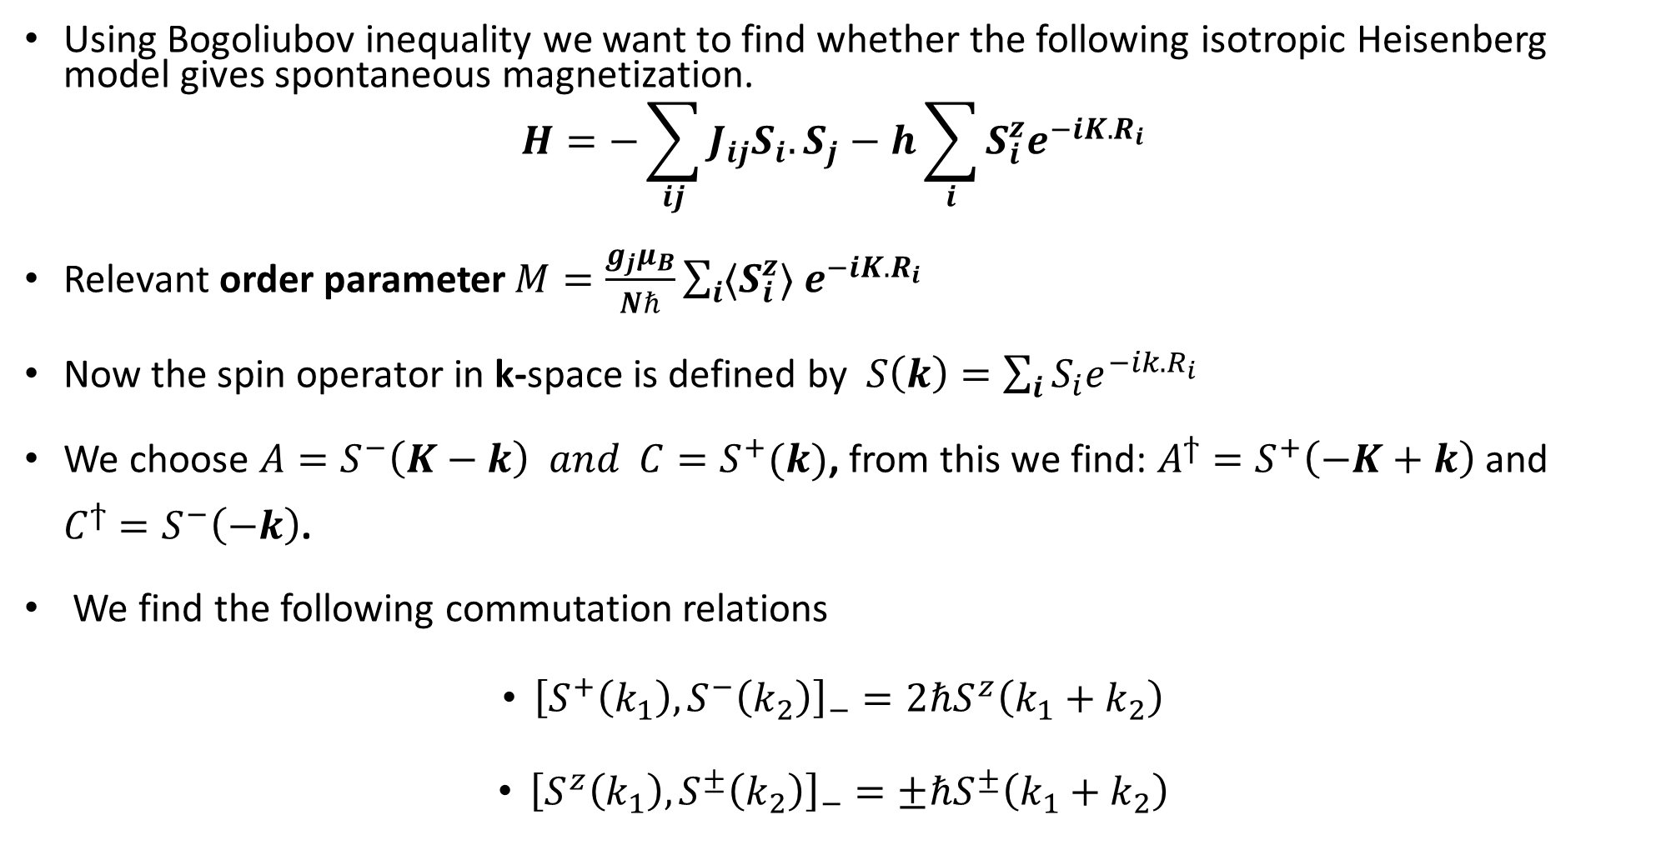
DERIVATION OF MERMIN-WAGNER THEOREM
Using Bogoliubov inequality we want to find whether the following isotropic Heisenberg model gives spontaneous magnetization.
$$H=−\sum_{ij}{J_{ij}S_{i}.S_{j}−h\sum_{i}{S_{i}^{z}e^{−iK.R_{i}}}}$$
Relevant order parameter $M=\frac{g_{j}μ_{B}}{Nℏ}\sum_{i}{{〈S}_{i}^{z}〉 e^{−iK.R_{i}}}$
Now the spin operator in k-space is defined by $S\left(k\right)=\sum_{i}{S_{i}e^{−ik.R_{i}}}$
We choose $A=S^{−}\left(K−k\right) and C=S^{+}(k)$, from this we find: $A^{ϯ}=S^{+}\left(−K+k\right)$ and $C^{ϯ}=S^{−}\left(−k\right)$.
We find the following commutation relations
${\left[S^{+}\left(k_{1}\right),S^{−}\left(k_{2}\right)\right]}_{−}=2ℏS^{z}\left(k_{1}+k_{2}\right)$
${\left[S^{z}\left(k_{1}\right),S^{±}\left(k_{2}\right)\right]}_{−}=±ℏS^{±}\left(k_{1}+k_{2}\right)$

Slide 18
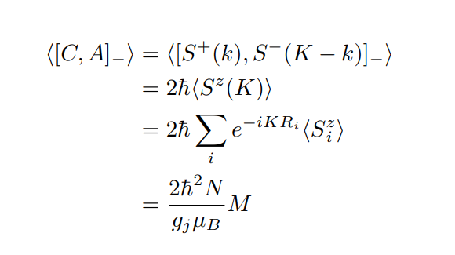

Now using commutation relations we will evaluate the following terms in the Bogoliubov inequality:
Term 1: $〈{\left[C,A\right]}_{−}〉$
Term 2: $\sum_{k}{〈{\left[A,A^{ϯ}\right]}_{+}〉}$
Term 3: $〈\left[{\left[C,H\right]}_{−},C^{ϯ}\right]〉$
Term 1:

Slide 19
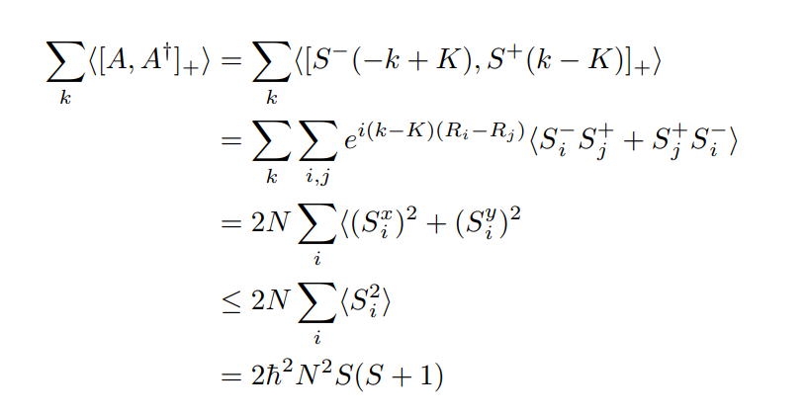
Term 2:

Slide 20

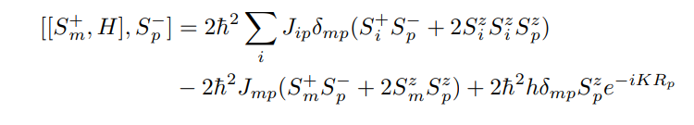

Term 3:
First we will evaluate ${[S}_{m}^{+},H]_$
We find

Slide 21
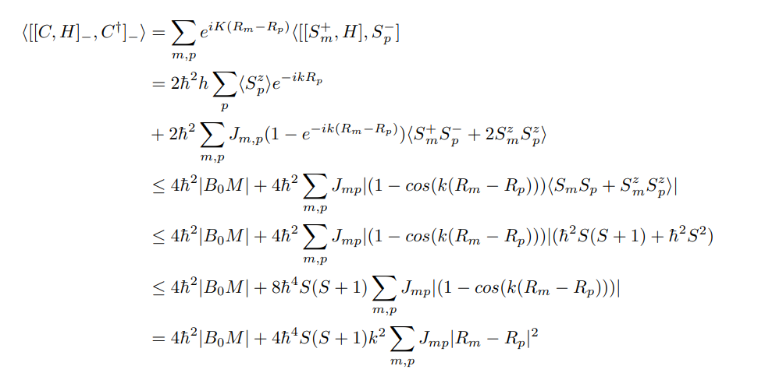
Term 3 cont. :
The two previous equations lead to

Slide 22
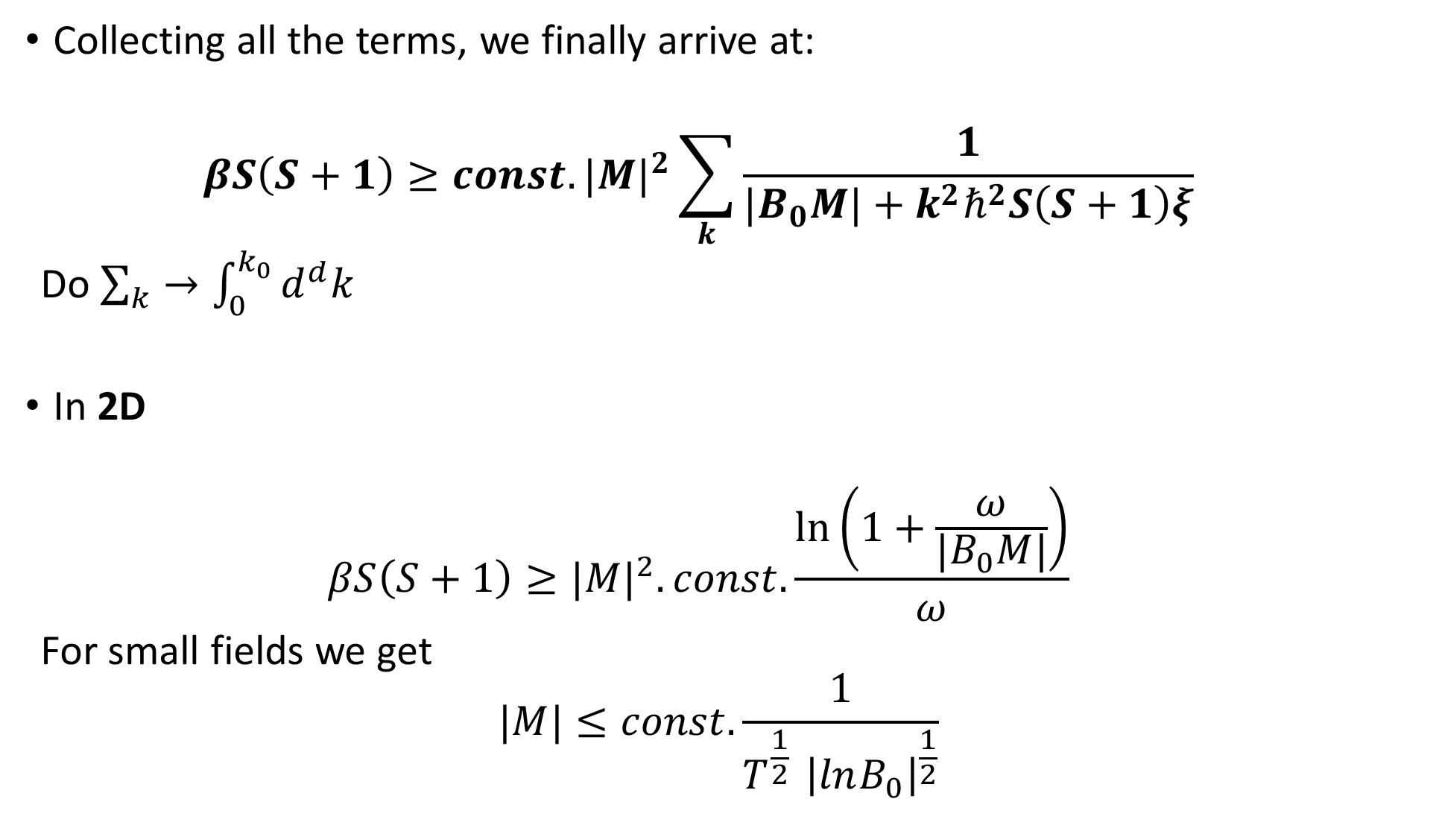
Collecting all the terms, we finally arrive at:
$$βS\left(S+1\right)≥const. {|M|}^{2}\sum_{k}{\frac{1}{{|B}_{0}M|+k^{2}ℏ^{2}S\left(S+1\right)ξ}}$$
Do $\sum_{k}{→\int_{0}^{k_{0}}{d^{d}k}}$
In 2D
$$βS\left(S+1\right)≥{|M|}^{2}.const.\frac{\ln\left(1+\frac{ω}{{|B}_{0}M|}\right)}{ω}$$
For small fields we get
$$|M|≤const.\frac{1}{T^{\frac{1}{2} }{\left|lnB_{0}\right|}^{\frac{1}{2}}}$$

Slide 23
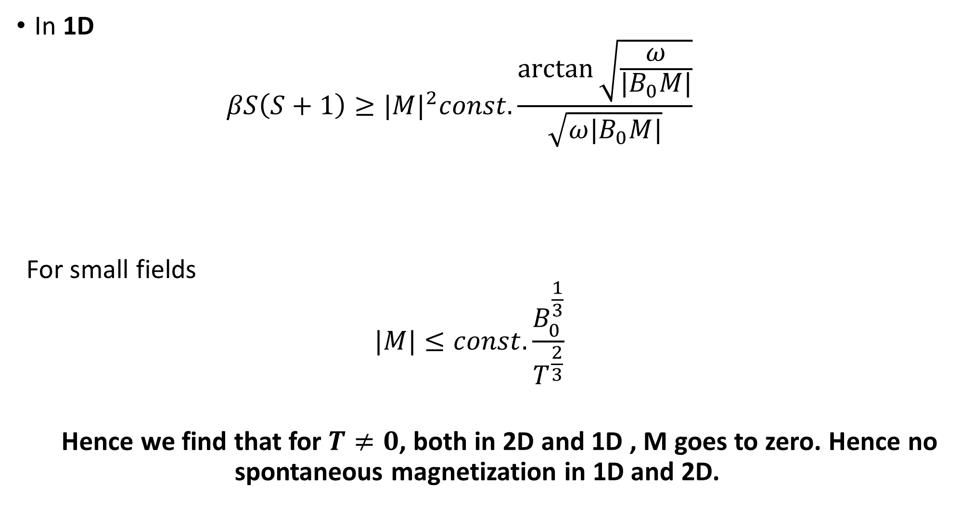
In 1D
$$βS\left(S+1\right)≥{|M|}^{2}const.\frac{\arctan{\sqrt{\frac{ω}{{|B}_{0}M|}}}}{\sqrt{ω{|B}_{0}M|}}$$
For small fields
$$|M|≤const.\frac{B_{0}^{\frac{1}{3}}}{T^{\frac{2}{3}}}$$
Hence we find that for $T≠0$, both in 2D and 1D , M goes to zero. Hence no spontaneous magnetization in 1D and 2D.

Slide 24
SOME DISCUSSION
The theorem is valid for arbitrary spin S
The theorem is valid only for the isotropic Heisenberg model. The proof is not valid even for a weak anisotropy.
The theorem is restricted only to the non-existence of spontaneous magnetization. It does not exclude possibility of other type of phase transition.

Slide 25
THANK YOU

